Slide 1
EDUC 200C
Section 5–Hypothesis Testing Forever
November 2, 2012

Slide 2
Goals
Quick review of hypothesis testing
Confidence intervals
Stata
Practice Problem
Questions?

Slide 3
Review of the General Idea of Hypothesis Testing
We’re good at “the SAT question”—given a population mean and standard deviation, how rare is observing a particular score? (we all know our percentile on the GRE, for example, and what that means)
Hypothesis testing is the same, except we have:
  Sample means instead of test scores
  Null hypothesis instead of population mean
  Standard error instead of standard deviation
We want to know, is our sample mean likely to have come from the population described by the null hypothesis?

Slide 4
Confidence Intervals
Allows us to give a range of scores in which we are “confident” that the true mean of the population our sample was drawn from resides.
We know our sample mean has a 95% chance of being within a certain distance of the mean of the true population from which the sample was drawn (this might not be the null hypothesis population)
What is this distance?
  Depends on the critical t value of our sample, t_{α}

Slide 5
Confidence intervals with Z-scores
We know with 95% confidence that our sample mean is no more than 1.96 standard deviations from the true mean.
That is, the z score of the true mean (of the population from which our sample was drawn…might not be null hypothesis population) is within 1.96 of our sample mean z score.
Another way to see it: we reject the null hypothesis for any z value not between -1.96 and 1.96.

Slide 6
Confidence Interval math…
The z score of the true mean is always zero
Substitute the z score formula
Multiply by the standard error
Add the population mean

Slide 7
Confidence Intervals
Thus we have that the true population mean lies, with 95% confidence in the range
We can generalize this for other levels of confidence by changing our critical z value
We can also generalize for the t distribution

Slide 8
Stata…
Quick command to describe your data
summarize varname
This also has the “detail” option, which gives more detail
“Summarize” can be shortened to “sum” and “detail” to “d” so we can write
summarize varname, detail
Or
sum varname, d

Slide 9
Say we have a sample of reading scores…
. sum rdg
Variable | Obs Mean Std. Dev. Min Max
-------------+--------------------------------------------------------
rdg | 300 52.444 9.977027 31 76
. sum rdg, d
RDG
-------------------------------------------------------------
Percentiles Smallest
1% 33.6 31
5% 36.3 33.6
10% 38.9 33.6 Obs 300
25% 44.2 33.6 Sum of Wgt. 300
50% 52.1 Mean 52.444
Largest Std. Dev. 9.977027
75% 60.1 73.3
90% 65.4 73.3 Variance 99.54107
95% 68 76 Skewness .1310203
99% 73.3 76 Kurtosis 2.272609

Slide 10
Using Stata to test our null hypothesis
Kenji talked yesterday about running a t-test to test our null hypothesis.
You can use this to compare the mean of a sample to a particular value.
ttest var==[null hyp. value]

Slide 11
. ttest rdg==50
One-sample t test
------------------------------------------------------------------------------
Variable | Obs Mean Std. Err. Std. Dev. [95% Conf. Interval]
---------+--------------------------------------------------------------------
rdg | 300 52.444 .5760239 9.977027 51.31043 53.57757
------------------------------------------------------------------------------
mean = mean(rdg) t = 4.2429
Ho: mean = 50 degrees of freedom = 299
Ha: mean < 50 Ha: mean != 50 Ha: mean > 50
Pr(T < t) = 1.0000 Pr(|T| > |t|) = 0.0000 Pr(T > t) = 0.0000

Slide 12
. ttest rdg==50
One-sample t test
------------------------------------------------------------------------------
Variable | Obs Mean Std. Err. Std. Dev. [95% Conf. Interval]
---------+--------------------------------------------------------------------
rdg | 300 52.444 .5760239 9.977027 51.31043 53.57757
------------------------------------------------------------------------------
mean = mean(rdg) t = 4.2429
Ho: mean = 50 degrees of freedom = 299
Ha: mean < 50 Ha: mean != 50 Ha: mean > 50
Pr(T < t) = 1.0000 Pr(|T| > |t|) = 0.0000 Pr(T > t) = 0.0000

Slide 13
. ttest rdg==50
One-sample t test
------------------------------------------------------------------------------
Variable | Obs Mean Std. Err. Std. Dev. [95% Conf. Interval]
---------+--------------------------------------------------------------------
rdg | 300 52.444 .5760239 9.977027 51.31043 53.57757
------------------------------------------------------------------------------
mean = mean(rdg) t = 4.2429
Ho: mean = 50 degrees of freedom = 299
Ha: mean < 50 Ha: mean != 50 Ha: mean > 50
Pr(T < t) = 1.0000 Pr(|T| > |t|) = 0.0000 Pr(T > t) = 0.0000

Slide 14
Practice Problem
Fifteen years ago a complete survey of undergraduate students at a large university indicated that the average student smoked an average of 8.3 cigarettes per day. The director of the student health center wishes to determine whether the incidence of cigarette smoking at his university has decreased over the 15-year period. He obtains the following results from a recently selected random sample of undergraduate students:
  What are H₀ and H₁?
  Can you reject the null hypothesis with α=0.05?
  What is the 95% confidence interval for the true value of current mean cigarettes smoked per day?
  Draw final conclusions

Slide 15
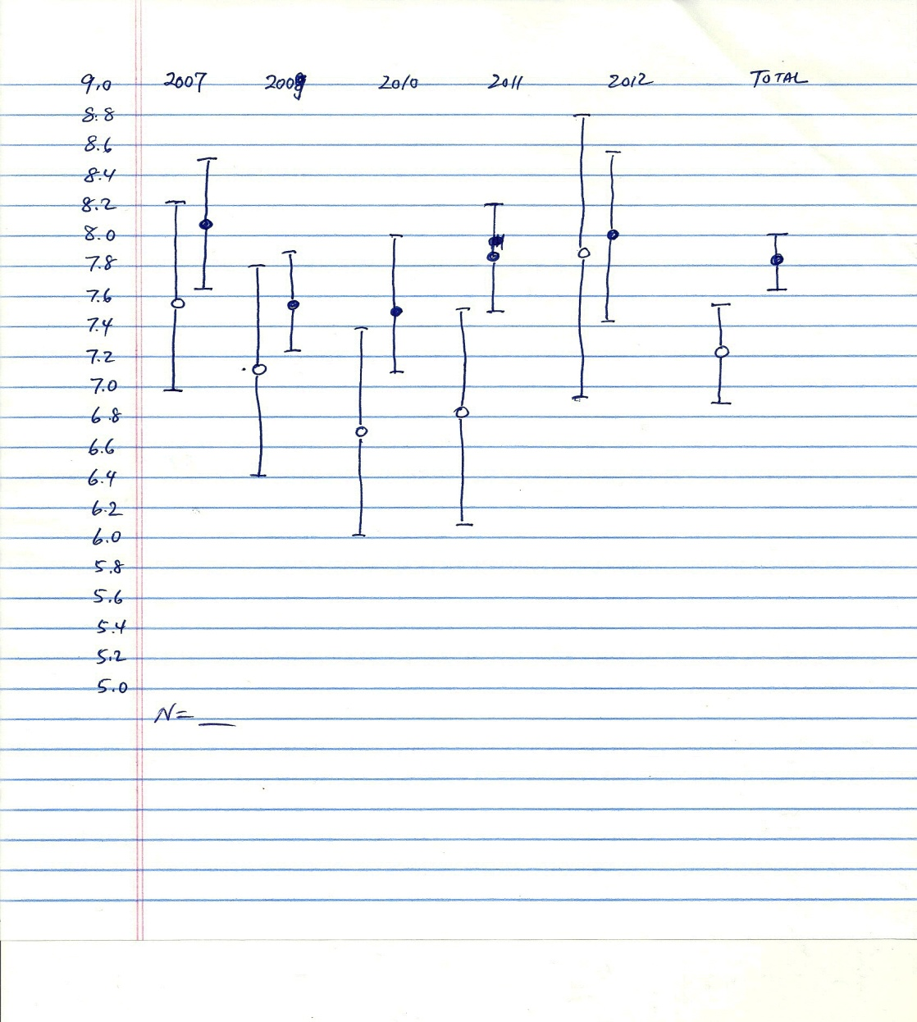
Confidence Intervals for Hands data

Slide 16
Questions?

